Slide 1

FIFA 18 – Data Analysis
-Harsh Takrani
-Pranay Lulla

Slide 2

Project Goals
Collecting, preprocessing and loading complete dataset of players
Clustering top players based on Overall Rating
To identify best possible squad based on two formations
Clustering young underrated players with high potential
Sentiment analysis using Twitter to understand feedback of FIFA 18
Applying Machine Learning Algorithm for prediction purposes
Creating basic visualizations like Histograms and Line charts

Slide 3
Data Sources
www.sofifa.com – To get complete dataset of FIFA 18, flexible data source as per parameters required for analysis
www.twitter.com – To extract tweets to analyze the sentiments of customers using the product

Slide 4
Data Preprocessing
Collected data from sofifa.com and analyzed the important parameters and removed the redundant ones
Changing data types as per requirement
Cleaned the Value and Wage columns using functions
Eliminating special characters in Skills and Finishing columns

Slide 5
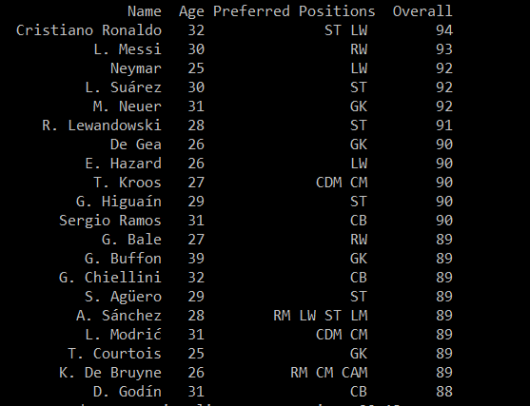
Basic Analysis: Finding Top 20 Players

Slide 6
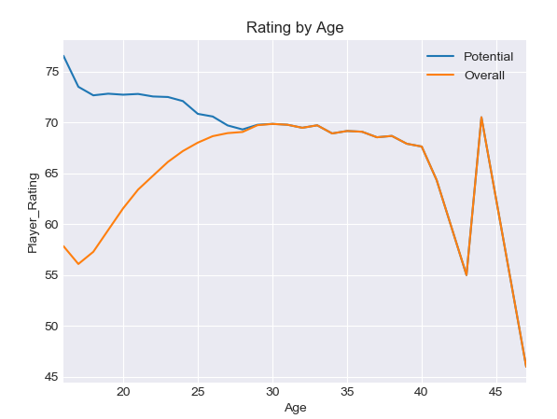
Basic Visualization: Potential vs Overall
Visualizing the peak of player using overall
Grouping the players by age
Getting a visualization by age of player and overall

Slide 7
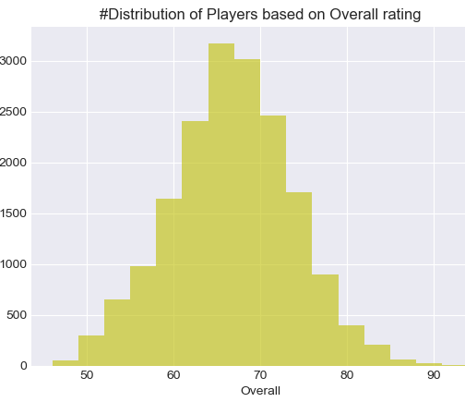
Basic Visualization: Histogram

Slide 8
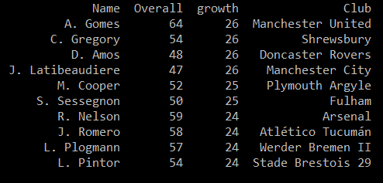
Finding Young Underrated Players
Here we create a growth column that helps us understanding how much a player’s rating can be improved
This helps us finding young underrated players which can be used by players to build a team in FIFA ULTIMATE TEAM (FUT) for cheap prices

Slide 9
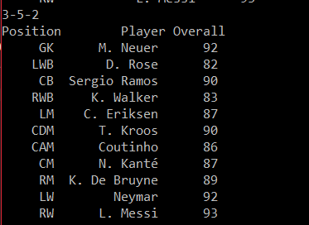
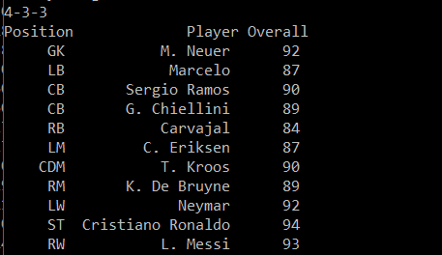
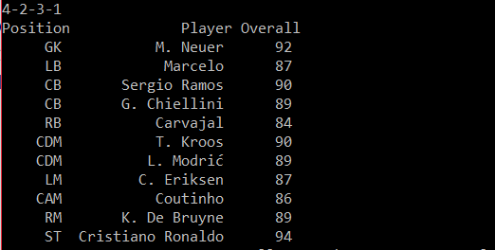
Best Squad Analysis: Formation Dependent
Here, we have created three functions based on three formations: 4-3-3, 4-2-3-1 and 3-5-2
The function identifies one position from preferred positions
Then it returns output which contains a data frame of 11 players with position, name and rating

Slide 10
Machine Learning
Divided the data into test and train datasets using library model selection
Train data was used to train the model
Test data was used to compare the values of prediction
The model is used to predict Value of player using Overall rating parameter

Slide 11
ML Techniques
Linear Regression
Used linear regression to predict the values
Mean Squared error:29.13
Support vector Regression
Used another modelling technique: SVR using radial basis function for non-linear problems
Mean Squared Error: 13.47

Slide 12

Twitter Analysis
Extracted the data of FIFA from twitter
Converted the data in to text
Created a data frame with attributes like Number of likes, Retweets count

Slide 13
Sentiment Analysis
Used Textblob package to calculate the polarity of tweets
The polarity was used to analyze the feedbacks on the tweets
The tweets were identified as positive, negative and neutral

Slide 14
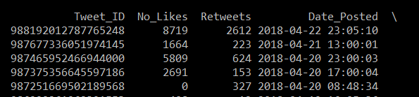
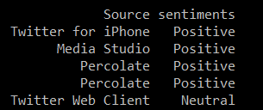
Sentiment Analysis Demo
Based on number of likes and retweets we can estimate the following of the game
Sentiments are used to identify the polarity of the game = .i.e. whether the tweets are positive, negative or neutral

Slide 15

Any Questions?

Slide 16
Thank You

